Slide 1
Me Time:
Mental Health App
Kaylene Noel, Sean Kirwin, & Lynn Nsubuga

Slide 2
Why we chose this topic?
We chose this topic to spread more awareness to mental health and how it should be taken more seriously
We also wanted to learn more about adding different features like music and journaling in our app using Android Studio

Slide 3

Tools that we used
Android Studio
Java

Slide 4
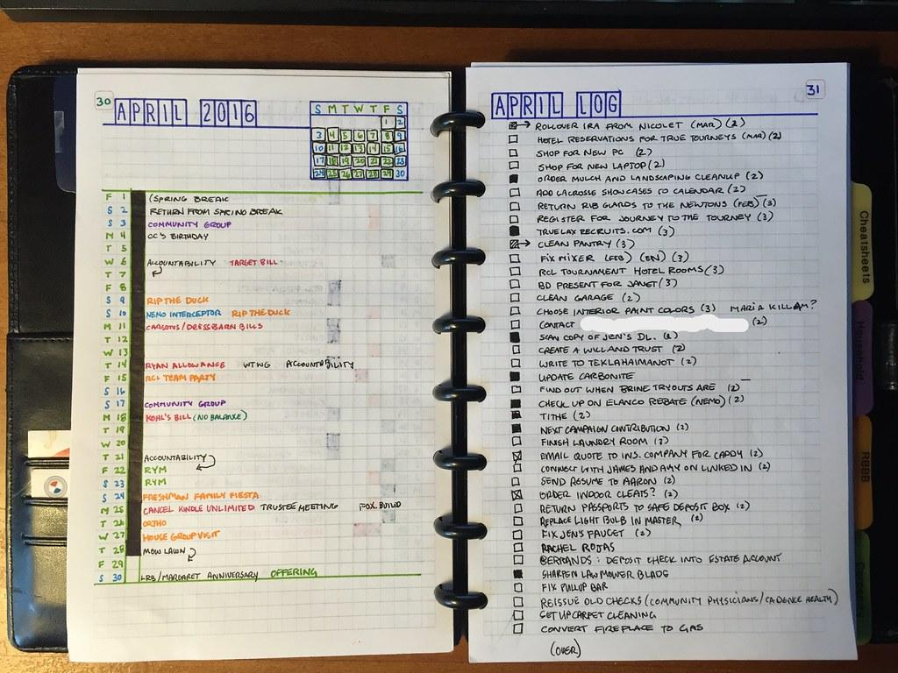
How does it work?
Our app allows the user to take a second for themselves by either listening to music, meditating, journaling, and a list of resources they have access to for example therapist recommendations.
We also added a types button that gives the user more information about the different types of mental health such as anxiety, depression, bipolar and PTSD.

Slide 5

What did we learn?
We learned how to create a timer for our meditation feature.
How to make an image open up a link for our music feature

Slide 6

What is the most important thing we’ve learned?
The most important thing we learned was making an image open up to a link allowing the user to access their music streaming service to relax their minds and express themselves.

Slide 7
How did we create it?
First we created a page for each of the main topics such as types, music, etc.
Next we created buttons that go back and forth between each page, After we go to each topic and added what we thought was needed
After those pages and buttons are created we got all the functions done like the timer and clickable images
After finishing all the functions we started designing our app to make it look nice

Slide 8

Results

Slide 9
What we should have done differently
We wished we’ve done more research on implementing certain things such as playing background music and being able to save each journal entry created.

Slide 10
Resources
https://medlineplus.gov/
https://www.tutorialspoint.com/
https://www.geeksforgeeks.org/what-is-uri-parse-in-android/
https://stackoverflow.com/questions/3536165/how-can-imageview-link-to-web-page

Slide 11
Thank you!

